Slide 1
Simulating and Visualizing Turbulent Fluid Mixing using 16,384 GPUs on LLNL's Sierra Supercomputer
Jason Burmark, Mike Collette, Cyrus Harrison, Matt Larsen, Brandon Morgan, Brian Pudliner, Brian Ryujin

Slide 2

The Sierra system will be LLNL’s first production GPU-accelerated architecture

Slide 3
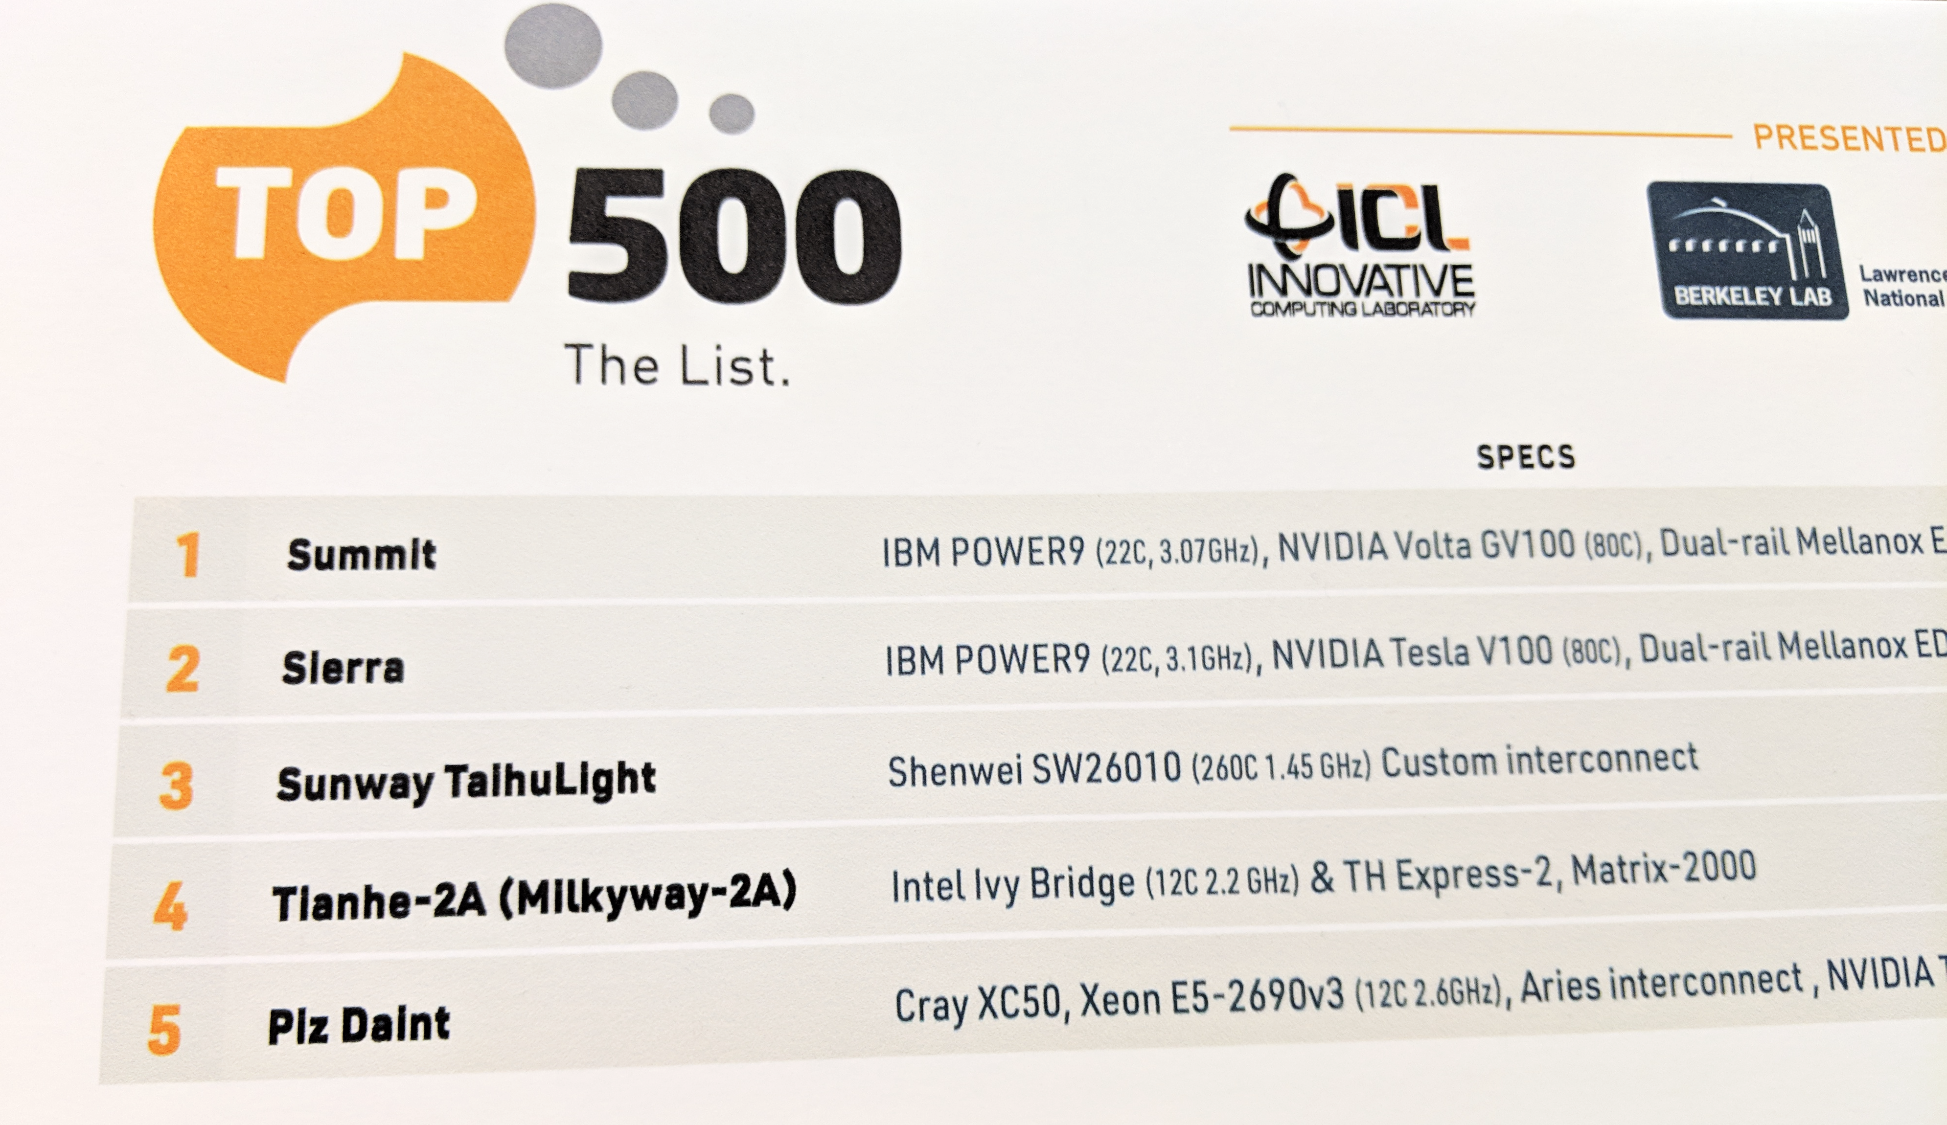
The Sierra system will be LLNL’s first production GPU-accelerated architecture

Slide 4
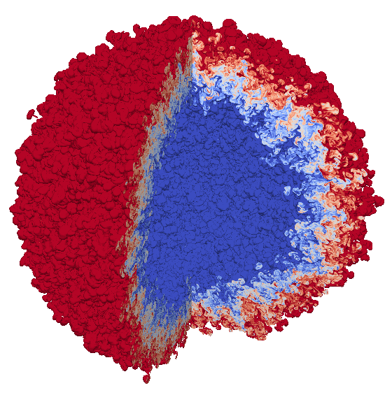
We ran a massive turbulent fluid mixing simulation on Sierra in October 2018
A high resolution simulation of two-fluid mixing in a spherical geometry was ran to gain insight into the growth of a Rayleigh-Taylor instability.
High resolution simulations of instability growth are not practical for routine use, so high resolution simulations like this help guide the development of sub-grid models that capture instability effects with much less computational cost and are used for both inertial confinement fusion and stockpile stewardship applications.
In-situ Visualization of Mixing Layer

Slide 5
This simulation was the first to utilize over 16,000 GPUs on Sierra
Highlights:
The 97.8 billion element simulation ran across 16,384 GPUs on 4,096 Sierra Compute Nodes
The simulation application used CUDA via RAJA to run on the GPUs
Time-varying evolution of the mixing was visualized in-situ using Ascent, also leveraging 16,384 GPUs
Ascent leveraged VTK-m to run visualization algorithms on the GPUs
The last time step was exported to the parallel file system for detailed post-hoc visualization using VisIt
This successful simulation is the result of many years of preparation!

Slide 6
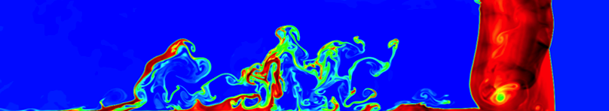
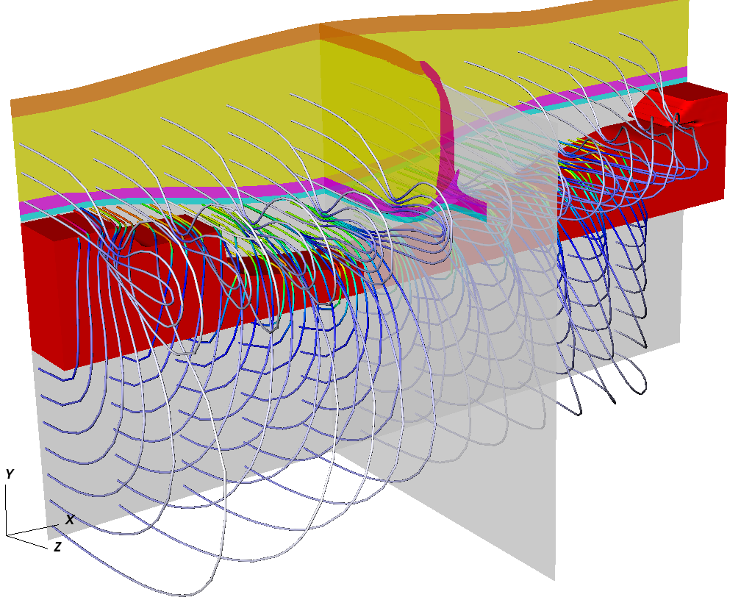
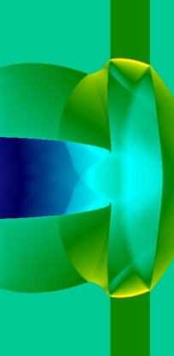
Porting the physics algorithms to the GPUs was a multi-year effort
LLNL’s Ares simulation code was used to run this simulation
The Ares simulation code base is ~800k lines C/C++
Integrates with 60+ libraries written in C, C++ and Fortran
Has scaled to over 1.5 million MPI processes
Ares has about ~5,000 mesh loops with limited hotspots
Lagrange hydro problems require 80+ kernels
Grey radiation diffusion problems require 250+ kernels
Arbitrary Lagrangian-Eulerian (ALE) hydro problems require 450+ kernels
The RAJA (https://github.com/llnl/raja) abstraction layer was key to incrementally port to GPUs, while maintaining a single-source code base
Ares is a multi-physics simulation application supporting:
Inertial Confinement Fusion (ICF)
Pulsed power
National Ignition Facility Debris
High-Explosive experiments

Slide 7
Porting the physics algorithms to the GPUs was a multi-year effort
Initial Investigations
Begin
GPU Development Branch Created
MPI + GPU
Support
Thermonuclear Burn
and Mix Model Support
Simultaneous use of GPUs + CPUs
Umpire and Ascent
Support
2015
2016
2017
2018
1st GPU Run
1st ALE Hydrodynamics
and Grey Radiation Diffusion Runs
97.8 Billion Element
Simulation on Sierra
1st Lagrange Hydrodynamics Run

Slide 8
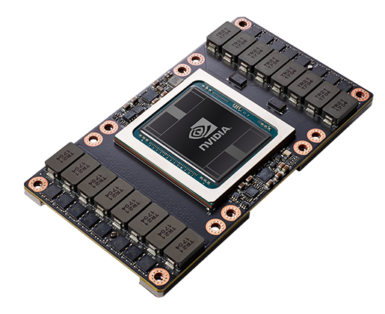
Porting has unlocked impressive performance on Sierra and positions us well for future architectures
Running physics algorithms on the GPUs allows us to scale and turn around massive simulations in a power efficient way
For this simulation, the physics calculations alone (excluding including setup, I/O, etc) took 60 hours of compute time on Sierra’s V100 GPUs
We estimate using the entire Sequoia system the same problem would take 30 days of physics compute time
Compared Node to Node to other HPC architectures, we expect Sierra will provide 6x to 12x faster simulation turn around time
Notes:
Gpus 9x better than just power 9s
60 hours compute vs 8 days of totral run time (due checkpoint to I/O and system stability issues) we expect 4 days
Seq-est: 30 days pure-compute, Ser: 60 hours pure-compute
Seq: using 1.5 million mpi tasks

Slide 9



Similarly, DOE’s visualization community has invested over many years to create tools for in-situ and GPU-enabled visualization
Strawman
EAVL
DAX
PISTON
Dist. Mem.
2010
2011
2012
2013
2014
2015
2016
2017
2018
ISAV17
Ascent
Data Parallel
Visualization Research
SC16
Performance Modeling (Strawman)
ECP Begins
ISAV15
Strawman
In-situ viz of 97.8 B Element
Simulation on Sierra using
Ascent
ASCAC Subcommittee on Exascale Computing

Slide 10
On Sierra, computation far outpaces our ability to save data to the parallel file system for detailed post-hoc visualization
Knowing this, we used a mix of in-situ (in-memory) and post-hoc (file-based) visualization:
In-situ: Use used Ascent (https://github.com/alpine-dav/ascent) to visualize the time-varying evolution of the mixing layer and export the final mesh data to compressed HDF5 files for post-hoc exploration
Ascent used VTK-m (http://m.vtk.org/) to run visualization algorithms on the GPUs
Post-hoc: We used VisIt (https://visit.llnl.gov) to explore details of final state at the final simulation state
In-situ visualization of the time-varying details of the simulation avoided terabytes of I/O vs post-hoc visualization

Slide 11
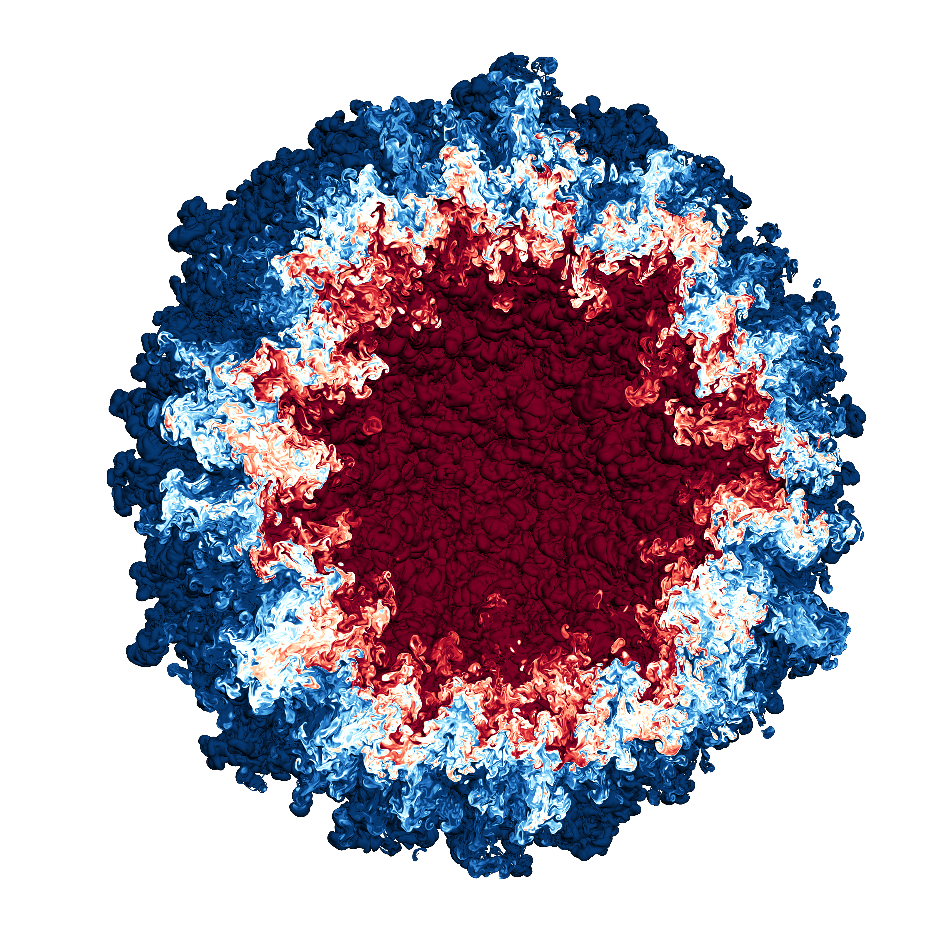
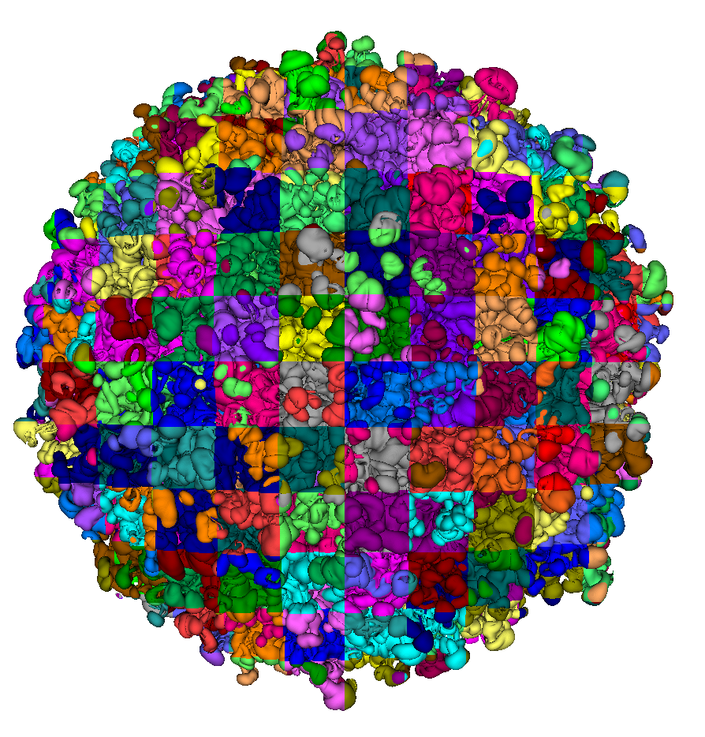

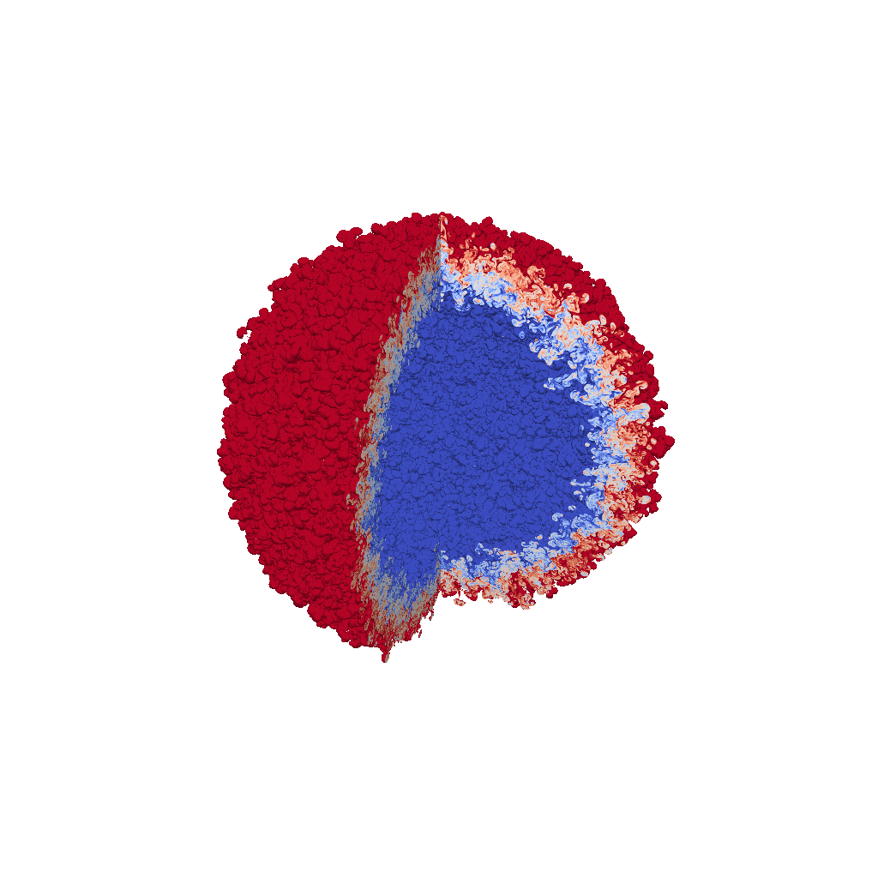
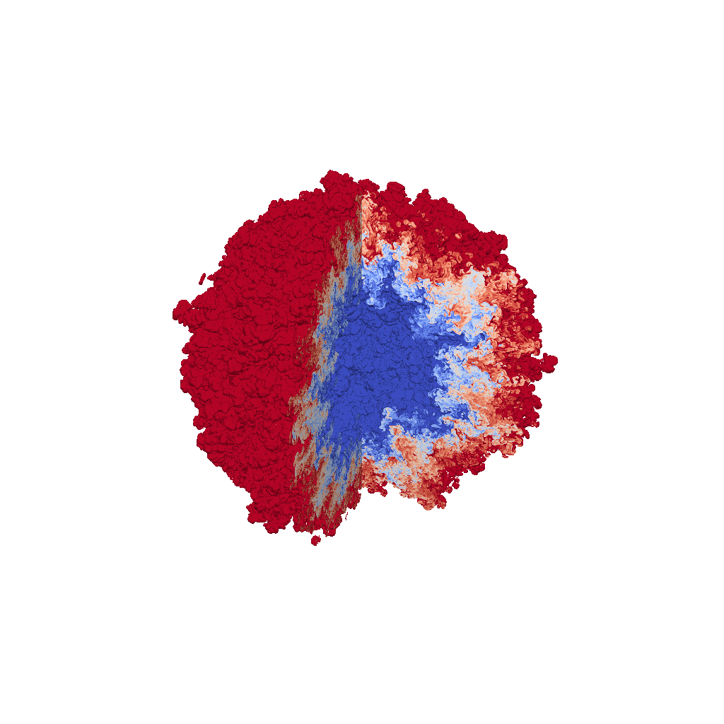
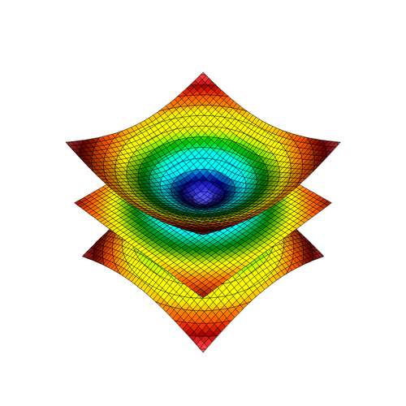

We used a mix of in-situ and post-hoc visualization to create a summary movie
Ares Multi-physics Application
Mesh State
Physics Algorithms (run on GPUs using RAJA)
$$S(t_{n}+∆t)={F(S(t}_{n}),∆t)$$
Images Rendered
In-situ
Compressed Mesh Data Files
Images Rendered
Post-hoc
VisIt

Slide 12
Summary Movie
THERE IS A MOVIE, BUT IT MAKES THE FILE SIZE 242MB.
REMOVE
-HC, 5/1/19

Slide 13
Conclusion: This successful simulation is the result of many years of preparation in both our simulation and visualization tools
Highlights:
The 97.8 billion element simulation ran across 16,384 GPUs on 4,096 Sierra Compute Nodes
The simulation application used CUDA via RAJA to run on the GPUs
Time-varying evolution of the mixing was visualized in-situ using Ascent, also leveraging 16,384 GPUs
Ascent leveraged VTK-m to run visualization algorithms on the GPUs
The last time step was exported to the parallel file system for detailed post-hoc visualization using VisIt
Links:
LLNL's Sierra Supercomputer: https://computation.llnl.gov/computers/sierra
RAJA https://github.com/llnl/raja
https://github.com/alpine-dav/ascent
http://m.vtk.org/
https://visit.llnl.gov
https://github.com/llnl/conduit
VisIt

Slide 14
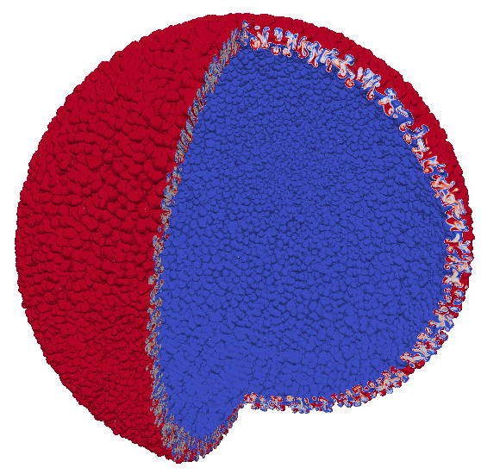
Selected Images from Ascent Renders

Slide 15

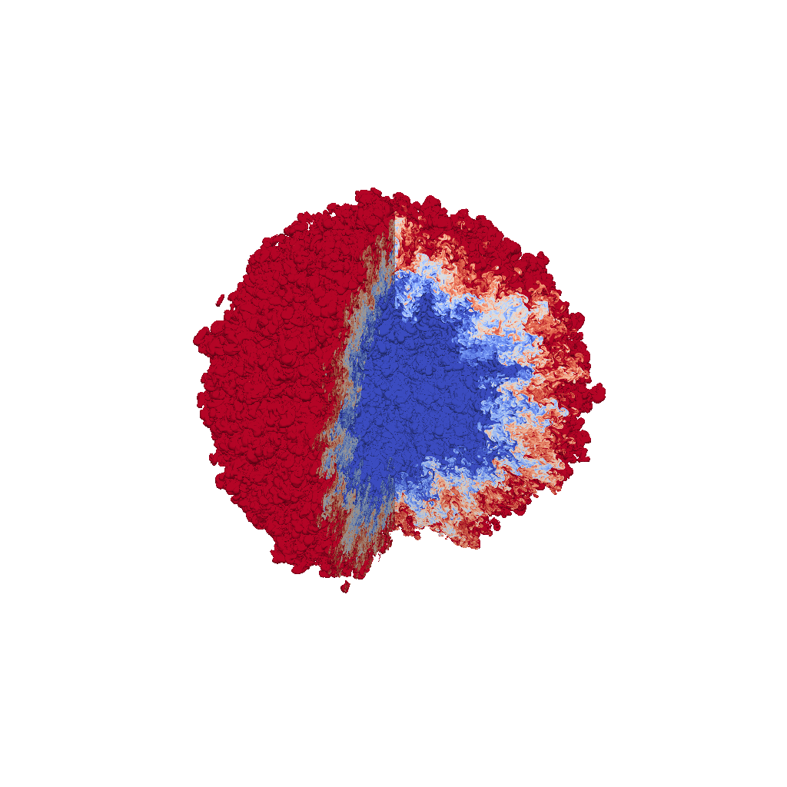
Selected Images from Ascent Renders

Slide 16

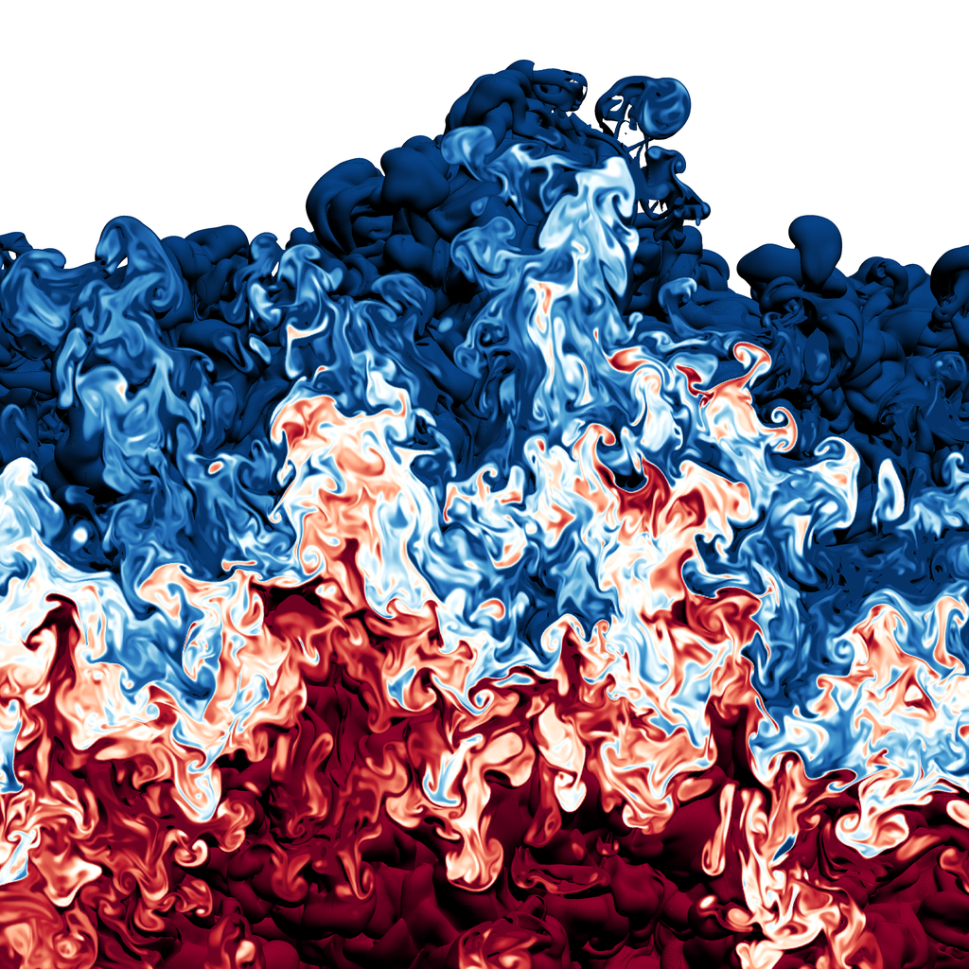
Selected Images from VisIt Renders

Slide 17
Selected Images from VisIt Renders

Slide 18
Selected Images from VisIt Renders

Slide 19
Selected Images from VisIt Renders

Slide 20
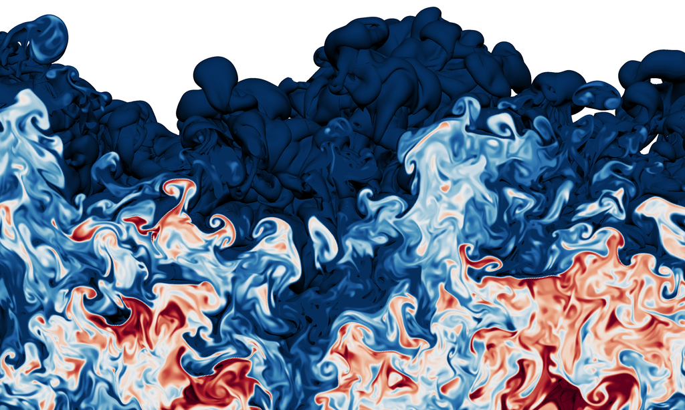
Selected Images from VisIt Renders

Slide 21
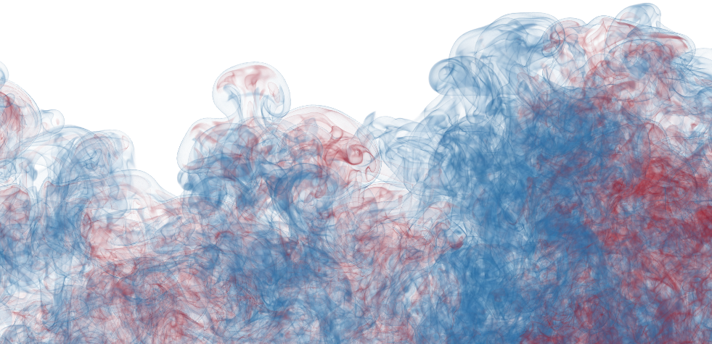
Selected Images from VisIt Renders

Slide 22




Acknowledgments
This work was performed under the auspices of the U.S. Department of Energy by Lawrence Livermore National Laboratory under contract DE-AC52-07NA27344. Lawrence Livermore National Security, LLC
This research was supported by the Exascale Computing Project (17-SC-20-SC), a collaborative effort of the U.S. Department of Energy Office of Science and the National Nuclear Security Administration.

Slide 23
Disclaimer
This document was prepared as an account of work sponsored by an agency of the United States government. Neither the United States government nor Lawrence Livermore National Security, LLC, nor any of their employees makes any warranty, expressed or implied, or assumes any legal liability or responsibility for the accuracy, completeness, or usefulness of any information, apparatus, product, or process disclosed, or represents that its use would not infringe privately owned rights. Reference herein to any specific commercial product, process, or service by trade name, trademark, manufacturer, or otherwise does not necessarily constitute or imply its endorsement, recommendation, or favoring by the United States government or Lawrence Livermore National Security, LLC. The views and opinions of authors expressed herein do not necessarily state or reflect those of the United States government or Lawrence Livermore National Security, LLC, and shall not be used for advertising or product endorsement purposes.

